Slide 1
CREST November 21

Slide 2
AGENDA
Welcome
SERCC/mobile crisis updates
Suicide Prevention work
MDH workgroup
Data Reports
Direct Care and Treatment
MHIS reports
Strategic Planning Goals
Budget
Grant Management Documents
DHS AMHI reform updates

Slide 3
MDH Suicide Prevention

Slide 4
Data Reports
Preliminary look at data reports
What would be helpful?
Please connect if you’d like to schedule something for your agency

Slide 5
Top primary diagnosis - all 10 counties in CREST combined
The data below represent primary diagnosis data for all 10 CREST counties combined, based on the percent of total distinct clients.
Percentages in bold indicate the top 3 for each calendar year.
 |  | Pre-covid |  | During Covid
 | Primary diagnosis based on MHIS diagnosis codes | CY2018 | CY2019 | CY2020
 | Mood [affective] disorders (F30–F39) | 51.79% | 45.99% | 44.39%
 | Schizophrenia, schizotypal, delusional and other non-mood psychotic disorders (F20–F29) | 23.34% | 20.02% | 19.70%
 | Anxiety, dissociative, stress-related, somatoform and other nonpsychotic mental disorders (F40–F48.9) | 16.72% | 15.07% | 16.55%
 | Unknown | 1.81% | 20.27% | 17.25%
 | Disorder of adult personality and behavior (F60–F68.89) | 5.67% | 5.59% | 6.29%
 | Missing | 1.03% | 2.06% | 3.12%
 | Behavioral and emotional disorders with onset usually occurring in early childhood and adolescence (F90–F98.9) | 2.73% | 2.64% | 2.30%
 | Pervasive and specific developmental disorders (F80.81–F89) | 1.42% | 1.07% | 1.69%
 | Mental and behavioral disorders due to psychoactive substance use (F10–F19) | 0.85% | 0.89% | 1.71%
 | Pre-ICD10 Diagnosis | 0.14% |  | 0.03%
 | Mental disorders due to known physiological conditions (F01–F09) | 0.46% | 0.61% | 0.42%
 | Mental disorder, not otherwise specified | 0.07% | 0.03% | 0.37%
 | Other | 0.04% | 0.15% | 0.17%
 | Behavioral syndromes associated with physiological disturbances and physical factors (F50–F59) | 0.07% | 0.05% | 0.08%
 | No Diagnosis |  | 0.03%
 | Grand Total | 100.00% | 100.00% | 100.00%

Slide 6
Top three diagnoses across years
When top diagnoses were analyzed across years, looking at both the number of distinct clients and percentage of total reporting, the top 3 remained consistent.
 | Pre-covid |  | During covid
Primary Diagnosis | CY2018 | CY2019 | CY2020
Mood [affective] disorders (F30–F39) | 51.01% | 47.93% | 47.23%
Schizophrenia, schizotypal, delusional and other non-mood psychotic disorders (F20–F29) | 23.74% | 21.02% | 20.44%
Anxiety, dissociative, stress-related, somatoform and other nonpsychotic mental disorders (F40–F48.9) | 17.91% | 18.33% | 20.15%
Service utilization across years
Below are the top 3 services for each calendar year based on reviewing percent of total distinct clients reported.
 | Pre-covid |  | During covid
Service | CY2018 | CY2019 | CY2020
ARMHS: Adult Rehabilitative Mental Health Services | 40.26% | 38.06% | 40.03%
MH-TCM: Mental Health Targeted Case Management | 34.52% | 33.50% | 33.31%
CSP (Community Support Program Services) | 14.21% | 14.83% | 13.27%

Slide 7
Top service use across grant programs - all 10 counties in CREST combined
The data below represent the program treatment/service data for all 10 CREST counties combined, based on the percent of total distinct clients.
Percentages in bold indicate the top 3 per calendar year.
 |  | Pre-covid |  | During covid
 | Service | CY2018 | CY2019 | CY2020
 | ARMHS: Adult Rehabilitative Mental Health Services | 42.93% | 35.70% | 42.03%
 | Medication Management | 27.13% | 35.57% | 28.01%
 | MH-TCM: Mental Health Targeted Case Management | 23.31% | 30.56% | 31.69%
 | Outpatient Psychotherapy | 38.75% | 26.55% | 17.90%
 | CSP (Community Support Program Services) | 0.96% | 9.55% | 8.79%
 | Diagnostic Assessment | 8.78% | 4.50% | 5.73%
 | Housing with Supportive Services | 3.90% | 4.14% | 6.27%
 | IRTS: Intensive Residential Treatment Services | 4.36% | 3.86% | 4.21%
 | State-Operated Inpatient | 4.18% | 3.61% | 3.48%
 | DBT: Dialectical Behavior Therapy IOP | 1.49% | 3.53% | 4.52%
 | Crisis Residential | 1.59% | 2.49% | 1.94%
 | Tenancy Sustaining Services | 1.20% | 1.04% | 3.57%
 | BHH: Behavioral Health Homes | 4.00% | 0.03%
 | ACT: Assertive Community Treatment | 0.78% | 1.17% | 1.29%
 | Housing Transition Services (HWS) | 0.81% | 0.36% | 0.0093
 | Whatever It Takes Grant | 0.11% | 0.74% | 0.59%
 | Peer Support Services | 0.46% | 0.28% | 0.56%
 | Outreach Services (HWS) | 0.50% | 0.13% | 0.11%
 | General Case Management | 0.25% | 0.08% | 0.03%
 | Supported Employment | 0.0007 | 0.05% | 0.08%
 | Mental Health Innovations Grant |  | 0.10% | 0.03%
 | Day Treatment (Children's or Adult) | 0.04% | 0.03% | 0.03%
 | Youth ACT | 0.04%
 | Grand Total | 100.00% | 100.00% | 100.00%

Slide 11
SERCC Data

Slide 12
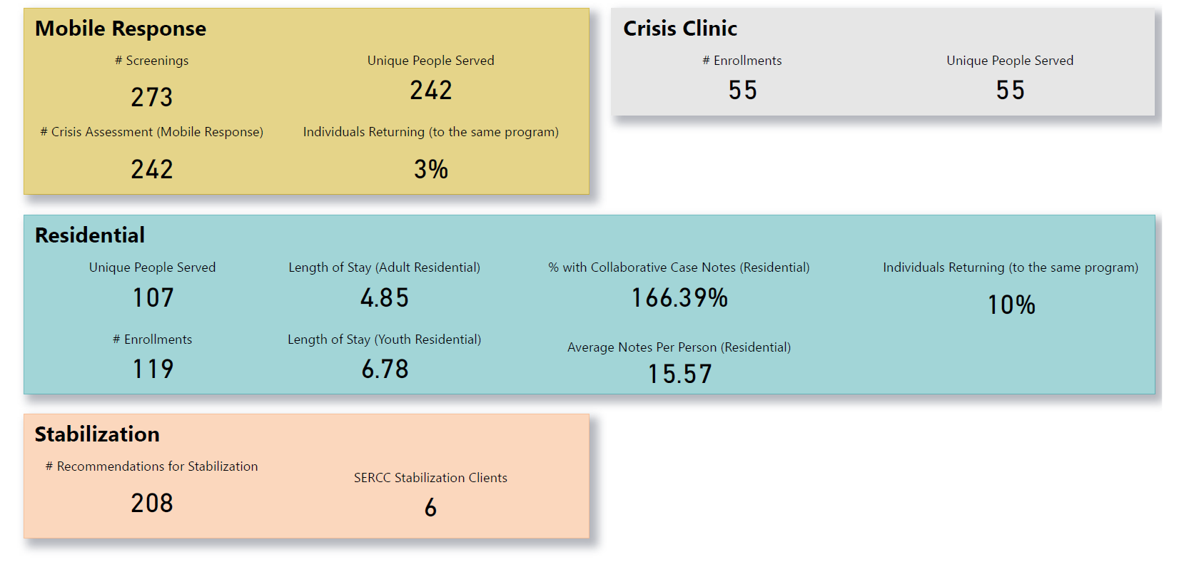

Slide 13
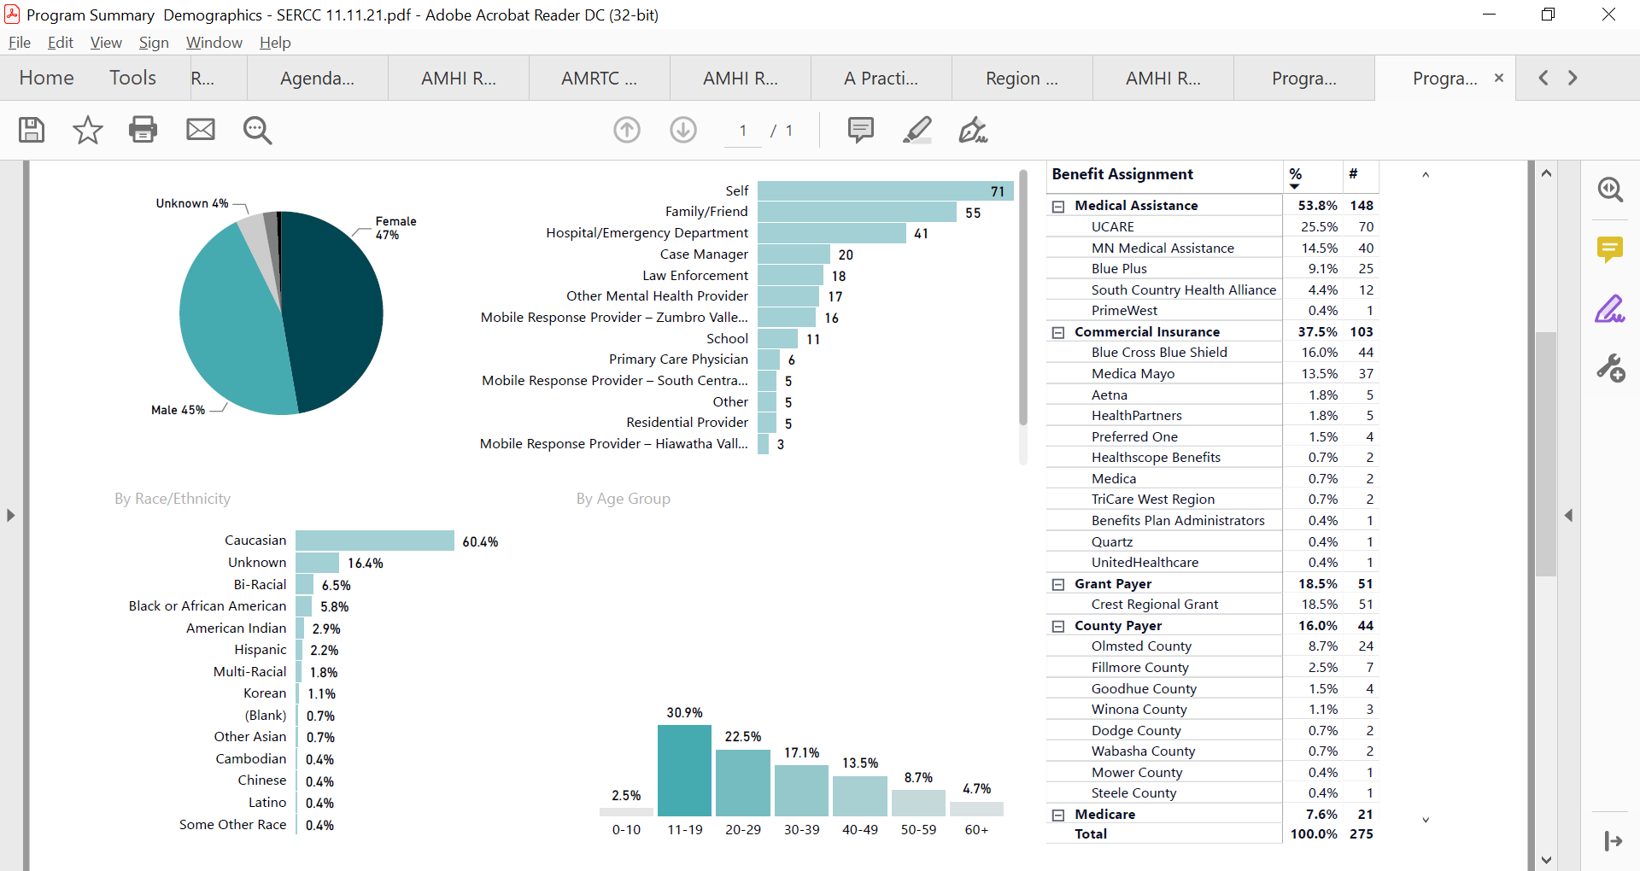

Slide 14
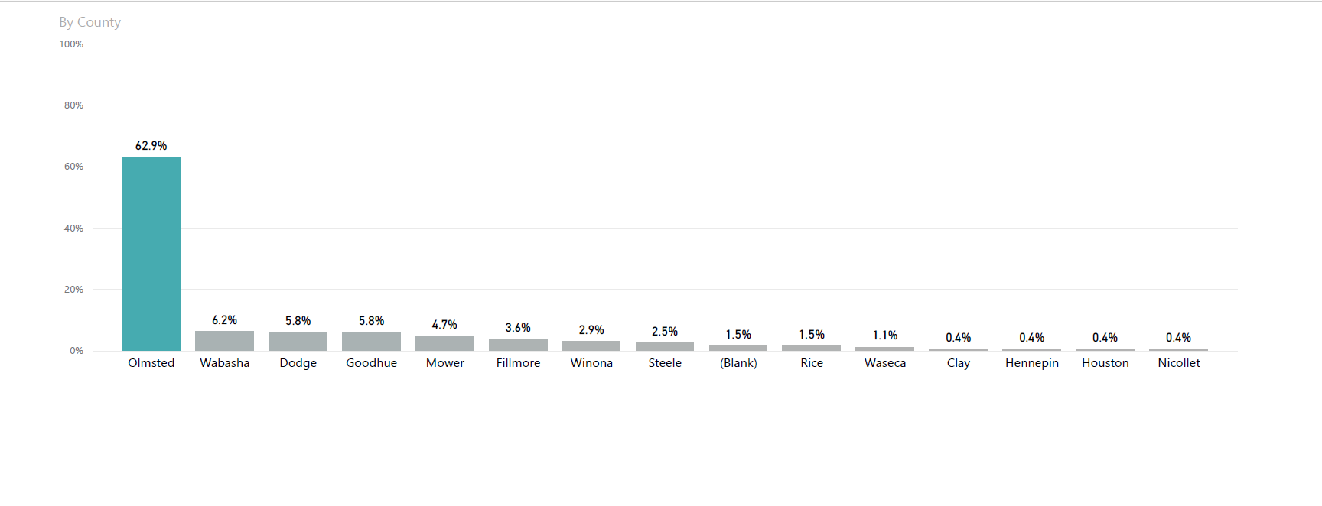

Slide 15
Strategic Planning Goals
Housing
Focus on high needs individuals
Supporting and educating landlords
Transportation
2 tier approach
Frontend real-time transportation
Protected Transport

Slide 16
Still to come
Linking data to legislative priorities
Bonding- IRTS expansion
Children’s RCS Medicaid benefit
AMHI policy change
Mortality data
DNMC- County Specific
Regional Health Data

Slide 17
AMHI Reform
Why create a funding formula?
Initial funding determinations for AMHIs were not uniform, equitable, or transparent, and were based on proximity to state hospitals that closed in the 1990s.
In 1996, six regions were funded with a total of $1.849M.
Today, 19 AMHI regions receive a total of $33.5M per year in funding.
Current allocations range from $1.49 to $21.29 per capita.
AMHI funding is vulnerable and has been reduced in the past (2003, 2005, and 2009) to cover costs of other services.

Slide 19
What is Rural?

Slide 20
Area Deprivation Index (income, education, employment, and housing quality)

Slide 21
What is the timeline?
Oct. 2019
DHS issued a quick-call for a vendor to assist in the development of a funding formula.
Apr. 2020 – June 2021
DHS contracted with Forma ACS to assist in developing a funding formula.
30 June 2021
Forma ACS presented a final formula model with usage recommendations to DHS.
June–Nov. 2021
AMHI stakeholder workgroup reviews formula work and provides recommendations about weights of formula variables to DHS.
Oct. 2021 – Dec. 2022
DHS in partnership with White Earth Nation develops pilot Tribal AMHI Funding Formula and determines implementation plan of Tribal AMHI funding formula.
Feb. 2022
Final recommendations of the funding formula are due in a report to the Minnesota Legislature.
June–Dec. 2022
In partnership with AMHI stakeholders, DHS develops implementation plan for new formula allocations.
Feb. 2023
DHS releases final implementation plan and announces formula-based allocations. Note: regional allocations are subject to changes brought about by additions or reductions of AMHI fund.
Apr. 2024
DHS releases AMHI grant plan application for the 2025-2026 funding cycle.
1 Jan. 2025
First contract round for formula-based allocations begins.

Slide 22
Anything else?

Slide 23
Budget
Spending update
Reminder: two-year grant cycle
Grant management forms
Sent out next week

